Slide 1
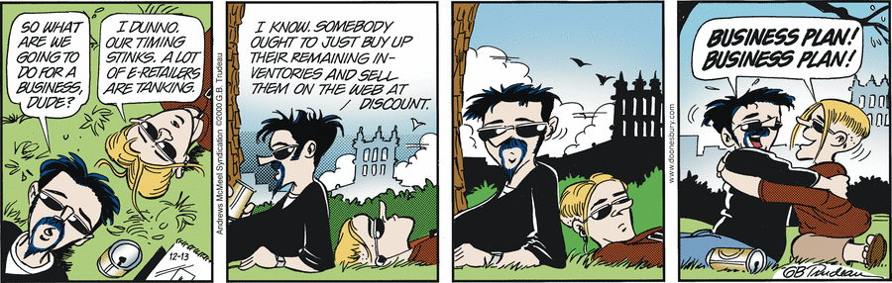
Business Context
Doonesbury, 12/13/2023

Slide 2
Business Proposal Documents
Purpose
    Communicate your idea to Sr. leaders and/ or investors
    Document what, who and why
What: The application (for software is). What it does, …
Who: Would want to use it, buy it, promote it, compete with it …
Why: It’s important to do. Socially, Financially, …

Slide 3
Business Proposal Document
Audience
Others in the company. Usually Sr. Leaders.
People who will review, approve, fund the proposal
Investors
    Outside people who may fund you
Board members

Slide 4
Key factors
Details, but not too much detail
Most of the focus is on ‘what’, not ‘how’
Include enough ‘how’ to give a flavour of the concept, or important technical factors that might come up as differentiators
E.g. If you have a breakthrough idea or invention, or if it is a controversial approach

Slide 5
Informal
Elevator Pitch
  “If you run into an influencer in an elevator, what would you say during the ride up”
Brief
Hits highlights
Conveys concepts and value
Generates interest for a follow up

Slide 6
Business Context
Essential business requirements
Projects are launched when the value of solving recognized problems exceeds the cost of doing so
Yes, Software Engineering requires Business awareness as well!!

Slide 7
Understand Business Context
Learn something about the application domain
Identify stakeholders
Project priorities
  Drivers: significant success objectives; e.g., profit margin
  Constraints: limiting factors – e.g., competition, time to market
  Degree of freedom: factors that can balance constraints and drivers; e.g. technology acquisition
Operating environment
  User environment
  Deployment environment

Slide 8
Business Drivers
Market share, competition
Product lines
Global markets
Revenue
Cost to develop, deploy, operate, and maintain
Personnel objectives
Liability, safety, reputation
Standards and regulations
Intellectual property
Environmental and sustainability concerns
[Market Requirements Document]

Slide 9
Stakeholders
What is a Stakeholder?
A stakeholder is any individual or organization which is actively involved in, materially affected by, or influences the outcome of the system
Examples:
Customers
  End users
  Purchasers
IT teams
Sales teams
…

Slide 10
Stakeholders
360 degrees of
perspective
Business Problem
Customers
Managers
Users
Analysts
Investors
Deployment
Development
Technical Writers
Developers
Service Providers
Testers
Maintainers
Technical Solution

Slide 11
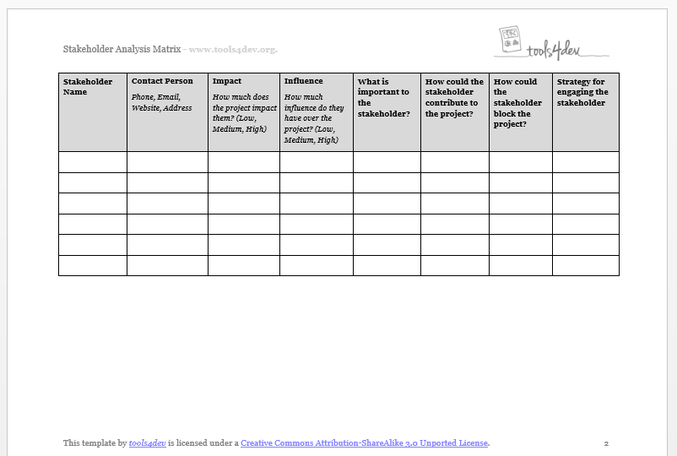

Slide 12
Formulate a Vision, Understand Scope
Gain understanding and agreement with the stakeholders on …
  Problem – the fundamental business opportunity or problem to be addressed
  Purpose – what the system is intended to do to address the problem
  Vision – the long term strategic purpose and intent of the system
  Scope – what portion of the long term vision the current system will address
  System Boundary (scope) – the boundaries of the problem and solution
May be documented in a Vision and Scope document

Slide 13
Problem Statement
Characterize the business opportunity
With the stakeholders (to achieve consensus), formulate a problem statement using the following template:
  The problem of <describe the problem>
  Affects <the stakeholders affected by the problem>
  The impact of which is <what is the impact of the problem>
  A successful solution would <list some key benefits of a successful solution>

Slide 14
Example Problem Statement
The problem of: untimely and improper resolution of customer service issues
Affects: our customers, customer support reps and service technicians.
The impact of which is: customer dissatisfaction, perceived lack of quality, unhappy employees and loss of revenue.
A successful solution would: provide real-time access to a trouble-shooting database by support reps and facilitate dispatch of service technicians, in a timely manner, only to those locations which genuinely need their assistance.

Slide 15
System Purpose
  What the system is intended to do to solve the problem
Essence: the fundamental purpose the system exists or will need to exist. This should tie to the original problem statement!
All requirements must contribute to this purpose
Example: an automated teller machine:
  Essence: withdraw money from my bank account
  Implementation: cards, PINs, buttons, etc.
  Lots of technological solutions, but only one essence/ essential goal
What features are suggested by the proposed solution?

Slide 16
Purpose, Advantage, Measurement
Purpose: a statement of what the system is supposed to do
Advantage: what business advantage does it provide?
Measurement: how do you measure the advantage?
Then analyze the cost-benefit tradeoff
  Reasonable? Is the system construction effort (cost) less than the advantage (value)?
  Feasible? Can the system achieve the measure?
  Achievable? Does the organization have (or can it acquire) the skills to build the system, and operate it once built?
[Robertson and Robertson]

Slide 17
Purpose, Advantage, Measurement (PAM) Example
Winter Road Maintenance system
  Purpose: To accurately forecast road freezing times and dispatch de-icing trucks
  Advantage: To reduce road accidents by forecasting icy road conditions
  Measurement: Accidents attributed to ice shall be no more than 15% of the total number of accidents during winter
Additional purpose
  Purpose: To save money on winter road maintenance costs
  Advantage: Reduced de-icing and road maintenance costs
  Measurement: The cost of de-icing shall be reduced by 25% of the current cost of road treatment, and damage to roads from ice shall be reduced by 50%
[Robertson and Robertson]

Slide 18
Vision Statement of the Solution
Strategic vision for how the system will achieve business objectives
  Decision making context during the system’s life cycle
Template approach with stakeholders to formulate a consensus system vision statement
  For <customer>
  Who <problem statement(s)>
  The <system name >
  Is <system category>
  That <key benefits>
  Unlike <existing or alternative solutions>
  Our system <is an x that provides y>

Slide 19
Example System Vision Statement
(Voting Machine)
For voters who need to vote electronically to comply with current election laws the RIT Voting Kiosk is an electronic voting machine that will comply with all election laws, provide an easy to use interface, and be fully secure. It will be highly reliable and easy to configure for new elections. Unlike previous voting machines in the market our system will redundantly record every vote on paper to enable recounts and prevent fraud.

Slide 20
Cautions
Functional requirements are typically what come out of problem and/ or vision statement
Implied requirements are often missed
E.g. Security, Simplicity, Quality
Common statement
- “I know I didn’t write it down, but it’s obvious, isn’t it?”
Lesson: “WRITE IT DOWN”!
From the ATM example, what are some likely ‘implied’ requirements

Slide 21
System Scope Analysis
Scope – what portion of the long term vision will the current system version address?
Provide development perspective in discussion with stakeholders to produce …
Project release plan - initial and subsequent release features
  What drivers and constraints?
  System product line strategy?
  System platform opportunities?
    Short versus long term investment

Slide 22
Determine System Boundaries

Slide 23
System Thinking
What is the system?
  All of the inputs
  All of the outputs
  All of the processing flow and data management that translates inputs into outputs
What is system thinking?
  Thinking strategically to visualize the holistic system solution
  Seeing the big picture
  Keep the system simple and management while maintaining completeness
System analyst/architect role/responsibility

Slide 24
System Thinking (cont)
Why is system thinking important?
Avoid missing requirements - understand the entire system problem
Stimulates innovative solutions thinking
Leads to extensible system architecture design
Scales and structures project scope planning
System solutions add value to the user and businesses
  The whole is greater than the sum of the parts, AND the whole adds value to each part

Slide 25
Establish the System Boundaries
Scope and scale
  What the system is
  What the system is not
  Draw a circle around the problem
Constraints
  Environment
  Budget
  Schedule
  Technology
  Politics
  Legacy systems to integrate or replace
Don’t boil the ocean!

Slide 26
Establish the System Boundaries
System boundary?
Is voice mail an actor or part of the system?
Voice Mail
Caller
(actor)
Simple Phone
System
Callee
(actor)

Slide 27
System Boundary?
Actors interact with the system
An actor is NOT part of the system
An actor could be:
  a human
  a device
  another system
Software and hardware infrastructure are NOT actors (they are part of the delivered system)
iDevice
iTunes

Slide 28
The Context Diagram
A useful graphical representation of the system to be developed
  A visual tool for stakeholder communications that is easy to understand
Establishes the system boundaries and connections
Simple graphical conventions:
  A central circle is the abstraction of the entire system – the boundary
  Surrounding rectangles represent terminators outside of the system that interface to it; people, other systems, organizations, devices
  Arrows between the system and terminators represent input and output flows of data, control, material

Slide 29
System Scope Representation
Context Diagram Example
Salesperson
Financial
System
Operator Actions
Operator
Responses
Payment Request
Payment Approval
Inventory
Record
Consumer Purchases
Consumer
Management
System
Inventory
System
Point of Sale
System
Marketing Collateral
Scanned Item Record
Receipt Record
Scanned Card Record
Scanner
Card Reader
Printer

Slide 30
References
Karl Wiegers, Software Requirements, 3rd Edition, Microsoft Press, 2003 (Chapter 5)
Suzanne Robertson and James Robertson, Mastering the Requirements Process, Addison-Wesley, 1999
Rational Unified Process, IBM

